Slide 1
THE NUTS AND BOLTS OF CAMPAIGNS
Planning a private equity in childcare campaign

Slide 2
Campaigns
1. Identify your base
2. Identify the issue(s)
3. Understand the root problem
4. Identify the decision maker(s)
  WHO has a common set of experiences or pain points that would give them a reason to unite make improvements?
  WHAT are the conditions/practices that impact your base, and may lead them to act to make change?
  WHAT are the conditions/practices that impact your base, and may lead them to act to make change?
  WHERE does the power to change/stop this live?

Slide 3
Campaigns
5. Create demands
6. Create a strategy
7. Develop tactics
8. Escalate
  WHAT actions could a decision-maker(s) take that would remedy issues you’ve identified?
  How do you get decision makers to implement your solutions? What is your north star goal? What campaign steps do you need to win along the way to get there? Do you need legislative, communications, basebuilding, and/or other strategies?
  WHAT actions put pressure on decision-makers to act on the demands? What would motivate them to want to fix your problem?
  WHEN do you plan to use these tactics, in what sequence and why? Tactics should build pressure. When will you reach peak pressure?

Slide 4
Theory Of Change
If we ______, then we can win_______ from ___________.
How we win is by executing strategies, and tactics aligned with those strategies, that build enough pressure on decision makers to implement your demands

Slide 5
WHAT TO KNOW ABOUT CHILDCARE AND PRIVATE EQUITY

Slide 6

Background
Investor-backed child care is 10-12% of the child care market in the United States - these centers care for 750,000 children every single day
The three largest, KinderCare, Learning Care Group, and Bright Horizons, operate [321 child care centers in California]
Resource: Toddlers and Investors Aren’t Playmates: The Threat of Private Equity in Childcare

Slide 7
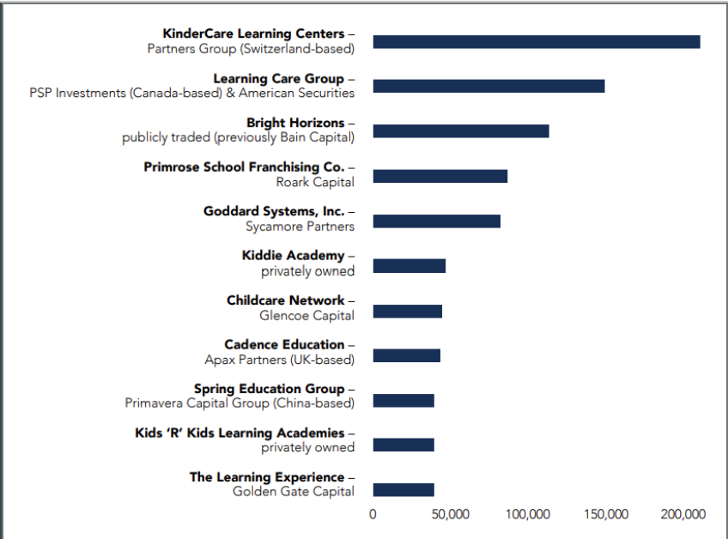
Size of private equity-owned chains
Source: Toddlers and Investors Aren't Playmates

Slide 8
Problems with Private Equity in childcare:
Kids aren’t a business!
High Turnover
  These centers are almost twice as likely to have a high turnover rate among staff because they might cut pay, benefits, or staff hours — or hire fewer teachers — to save money.
Low Quality
  Program quality is lower because with fewer teachers and less money for toys, books, food, or repairs, the environment is harder to maintain.
Only Serve Families that Can Pay Big $$$
  They intentionally cater to an affluent clientele or large businesses to charge excessive fees, investor-backed chains serve an extremely small proportion of low-income children. They want to make more money fast, so they may charge families higher tuition.

Slide 9
Problems with Private Equity in childcare:
Kids aren’t a business!
Threaten Community based, Community owned childcare
  PE companies can use capital advantage to consolidate the CC market leaving smaller community-based child care programs vulnerable to buyouts. -They may lobby for public funding and regulations that place strain on small childcare businesses
Threat to the Sector
  PE companies sole pursuit of profit leads to high risk behavior- Childcare is a socially important industry that should be protected—especially if a significant share of their revenues come from public funding.
Childcare Worker Pay Effects Teachers and Kids
  Profit motives incentivizes low pay- Child well-being is directly tied to conditions, pay and benefits of classroom teachers.

Slide 10
Discuss how YOU are affected by this.

Slide 11
What are Private Equity Firms? How Do They Operate?
Private Equity funds pool money from wealthy investors, and use that money and large bank loans to take control of businesses for a short period of time: They buy a business — like a child care center, housing, toy stores and take over the day-to-day operations.
They want to restructure those businesses and resell them at a profit: They cut costs to make more money and pay off their debts.
The need to increase profits quickly above anything else leads private equity firms to cut costs, lay off workers, and reduce quality of services and then they sell it fast for a profit.

Slide 12
Key Questions to Consider
What does private equity mean?
How are private equity companies getting involved in childcare, and what are the problems/risks?
What should statewide elected officials know about private equity in childcare?
How does private equity present an organizing opportunity?

Slide 13
How do we curb PE’s power in childcare?
1. Corporate Campaigns
2 . Guardrails for Funding
3. Executive/Regulatory Action

Slide 14
CASE STUDIES

Slide 15
Corporate Campaigns ex: Parent Voices CA
La Petite Academy is owned by Learning Care Group
Learning Care Group is the second largest childcare provider in the country
  1,100 schools in 40 states
Learning Care Group is owned by American Securities, LLC
  Private equity firm based in New York
  Manages $26 billion in assets
  CEO, Michael Fisch, has a purported net work of $10 billion

Slide 16

CORPORATE CAMPAIGN:
PVCA and La Petite
Demands were generated by:
Calling an organizing meeting of parents and teachers by Parent Voices of CA
Learning about American Securities
Identifying their problems
Demanding to speak with decision makers

Slide 17
Campaigns for Funding, with Guardrails
Massachusetts
  Guardrails in state C3 grants program
  Won through state budget fight
  Building off momentum, press from collapse of PE-owned hospitals in the state
Vermont
  New payroll tax for public investment in childcare
  Coalition where business community was central
  Won guardrails after a PE takeover led to steep tuition hikes

Slide 18
Executive/Regulatory Campaigns
Structural changes to administering agencies
Educating and aligning policy personnel on private equity landscape
New dedicated ECE agencies in NM, OR, MN
Co-governance model with centralized decision maker
Listening sessions and community events for implementation

